Slide 1
DISABILITY
Dr. Doss Prakash Dept. OF community physiotherapy MGM institute of physiotherapy CHH. SAMBHAJINAGAR

Slide 2
DISABILITY
Our views &
approach?

Slide 3
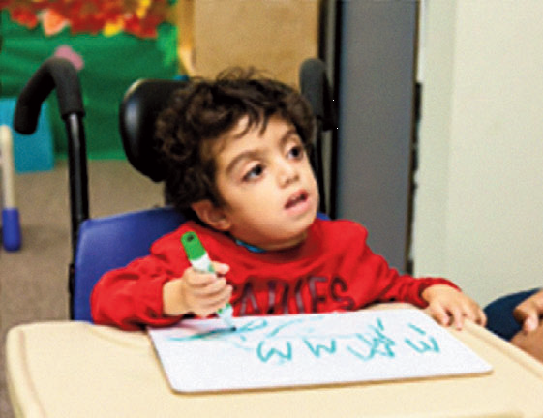
Hospitals &
Society / community

Slide 4
GLOBAL TRENDS

Slide 5
GLOBAL STATISTICS

Slide 7
EVOLUTION

Slide 9
BIOLOGICAL / MEDICAL PERSPECTIVE

Slide 10
EXAMPLES

Slide 11
Evolution (Contd)

Slide 12
CURRENT DEFINITIONS

Slide 13
VARIED EXPERIENCES

Slide 15
GLOBAL TRENDS / CAUSES

Slide 17
CHILDHOOD DISABILITIES

Slide 18
CATEGORIES

Slide 19
Categories

Slide 20
Contd

Slide 21
CAUSES

Slide 22
PRENATAL CAUSES

Slide 27
CHILDHOOD CAUSES

Slide 28
TYPES OF DISABILITY
DISABILITY
PHYSICAL
SENSORY
INTELLECTUAL
MENTAL ILLNESS

Slide 29
PHYSICAL DISABILITY
Physical disabilities may affect, either temporarily or permanently, a person’s physical capacity and/or mobility.
There are may different causes of physical disabilities but they can include inherited or genetic disorders, serious illnesses, and injury.

Slide 30
TYPES OF PHYSICAL DISABILITY
Acquired brain injury
Spinal cord injury (SCI)
Spina bifida
Cerebral palsy
Multiple sclerosis (MS)
Muscular dystrophy
Leprosy cured persons
Parkinsons disease
Chronic Neurological conditions – stroke, dystonia, stroke

Slide 31
SENSORY DISABILITY
A sensory disability is a disability of the senses (e.g. sight, hearing, smell, touch, taste).
Autism spectrum disorder (ASD)
Blindness and low vision
Hearing loss and deafness
Speech and Language disability

Slide 32
INTELLECTUAL DISABILITY
An intellectual disability may mean difficulty communicating, learning, and retaining information.
Fragile X syndrome
Down syndrome
Developmental delay

Slide 33
MENTAL ILLNESS
Different types of mental illness affect a person's thinking, emotional state and behaviours.
Bipolar disorder
Depression
Anxiety disorders
Schizophreni
Post-traumatic stress disorder (PTSD)
Mental Retardation

Slide 34
Others
Dwarfism
Thalasemia
Hemophilia
Sickle cell disease
Acid attack victims

Slide 35
PREVENTION

Slide 36
PREVENTION

Slide 39
TERITIARY PREVENTION

Slide 41
Physical Rehab Strategies
Early Detection & Prevention
Counseling & Medical Rehab
DDRC & ASHA workers
Assistive devices
Development of Rehab professionals

Slide 42
Educational Rehab
Article – 21A Fundamental Right - Education
Section 26 of PWD act free and compulsory education - minimum age of 18 years.
Sarva Shiksha Abhiyan (SSA) launched by the Government has the goal of eight years of elementary schooling for all children including children with disabilities in the age group of 6-14 years.
Children with disabilities in the age group of 15-18 years are provided free education under Integrated Education for Disabled Children (IEDC) Scheme.

Slide 43
Open learning system and open schools, alternative schooling, distance education, special schools, wherever necessary home based education, itinerant teacher model, remedial teaching, part time classes, Community Based Rehabilitation (CBR) and vocational education

Slide 44
Economic Rehab
The PWD Act, 1995 provides for 3% reservation in employment in the establishments of Government of India and Public Sector Undertakings (PSUs)
Wage employment
Vocational rehab
incentives, awards, tax exemptions
Self Employment

Slide 45
THANK YOU

